Slide 1

Real Life Application Of Graph
Section : A
Subject : SE123
Farjan Ahmmed
ID: 0242320005341738

Slide 2

Introduction to Graph Theory
Graph theory is a fundamental field of mathematics that has numerous applications in computer science and software technology. It provides a powerful framework for modeling and analyzing complex systems, networks and relationships between data elements.

Slide 3
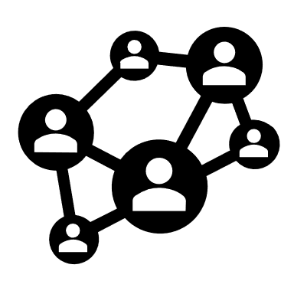



Representing Data Structures as Graphs
Networks
Hierarchies
Graphs can model complex networks like social connections, transportation routes or neural pathways in the brain.
Graphs can represent hierarchical data structures like file systems, organization charts or taxonomies.
Complex Systems
Knowledge Representation
Graphs provide a flexible way to model interrelated components in systems like the internet, epidemics or power grids.
Semantic networks and ontologies use graphs to capture relationships between concepts, enabling intelligent reasoning and search.

Slide 4
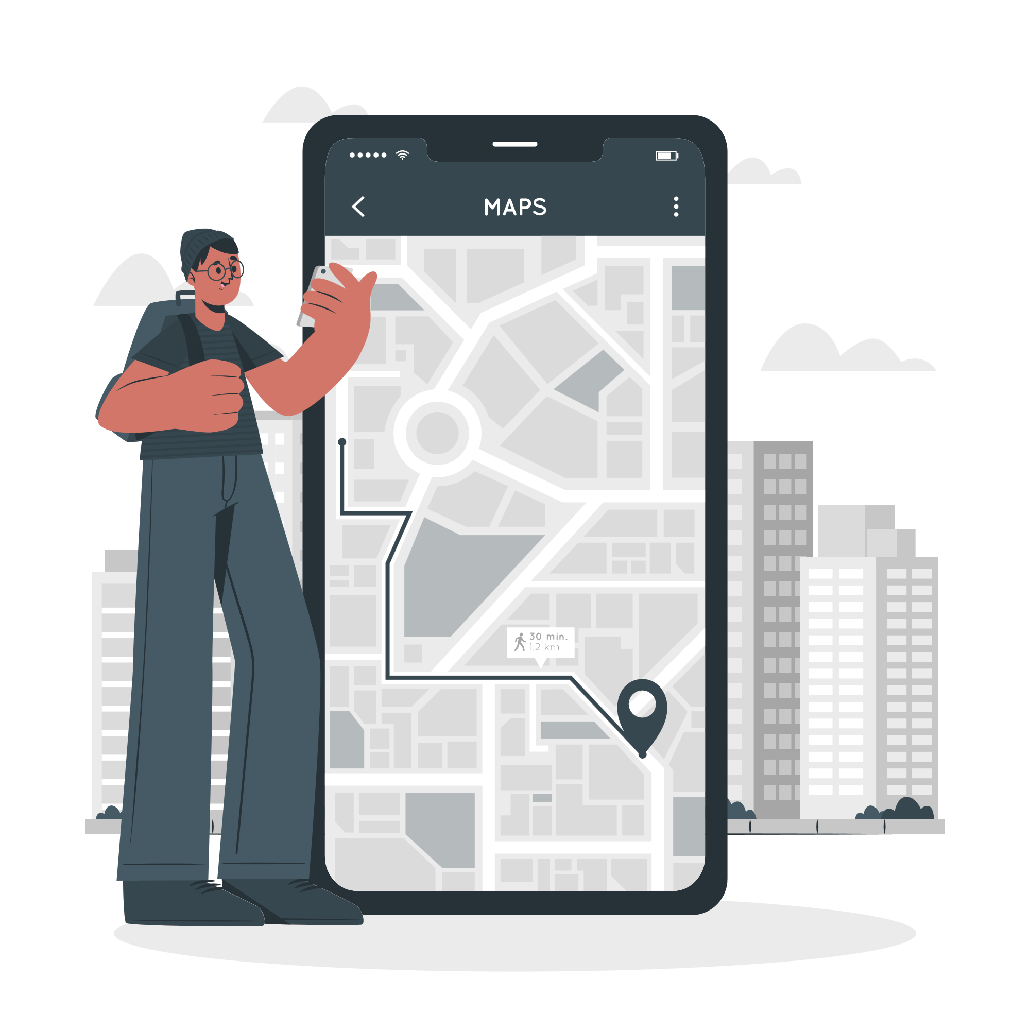
Shortest Path Algorithms and Routing
1
Dijkstra's Algorithm
This classic algorithm finds the shortest path between two nodes in a graph by efficiently exploring all possible routes and selecting the one with the lowest total cost.
2
A* Search
A more advanced algorithm that incorporates heuristics to intelligently guide the search, making it especially useful for pathfinding in video games and GPS navigation.
3
Routing Protocols
Graph theory is the foundation for the dynamic routing algorithms that power the internet, allowing data packets to find the most efficient paths through the network.

Slide 5

Social Network Analysis
Graph theory provides powerful tools for analyzing complex social networks. By modeling connections between people, organizations or entities as nodes and edges, we can uncover hidden relationships, influential individuals and community structures within large-scale social graphs.
Social network analysis enables us to visualize and quantify the dynamics of information sharing, collaboration, and influence across diverse social media and online communities.

Slide 6




Bioinformatics and Genomic Data Analysis
Computer Graphics and Gaming
Natural Language Processing
Circuit Design and Simulation
Network Security
3D models in games and animation software are often represented using graphs. Nodes represent vertices in the model, and edges define how they connect, forming the overall shape.
Graphs can model the structure of sentences and relationships between words. This proves valuable in tasks like machine translation, sentiment analysis, and building chatbots.
Electronic circuits can be represented as graphs, where nodes represent components like transistors and resistors, and edges denote connections between them. This facilitates circuit simulation and analysis.
Network security software employs graphs to model network infrastructure. They can identify vulnerabilities by analyzing connections and potential weaknesses in the network's overall structure.

Slide 7




Network Optimization and Logistics
Route Planning
Graphs are used to model transportation networks, allowing companies to find the most efficient routes for delivery vehicles and minimize fuel costs and travel time.
Supply Chain Management
Graphs represent the flow of goods through a supply chain, enabling businesses to identify bottlenecks, optimize inventory levels, and enhance overall supply chain efficiency.
Workforce Scheduling
Graphs model the dependencies and constraints involved in scheduling employees, vehicles, and other resources, leading to more balanced and productive work schedules.

Slide 8

Cybersecurity and Fraud Detection
Graphs play a crucial role in cybersecurity and fraud detection by modeling complex relationships between entities, such as users, devices, and transactions.
Graph algorithms can identify anomalies, detect patterns of suspicious activity, and uncover hidden connections that may indicate fraudulent behavior.
By leveraging graph-based techniques, security professionals can proactively defend against cyber threats and financial crimes, protecting organizations and individuals from devastating consequences.

Slide 9




Machine Learning and Graph Neural Networks
Predictive Modeling
1
Identifying patterns and making predictions from complex data
Graph Representation
2
Modeling data as interconnected nodes and edges
Neural Networks
3
Artificial intelligence inspired by the human brain
Graph Neural Networks
4
Combining graph theory and deep learning for powerful insights
Graph neural networks (GNNs) are a powerful machine learning technique that leverage the relational structure of data represented as graphs. By modeling the complex relationships between entities, GNNs enable predictive modeling, classification, and optimization tasks across a wide range of applications, from social network analysis to drug discovery.

Slide 10
Conclusion and Future Trends
Boundless Potential
Intelligent Interconnections
Graph theory and its applications in computer science are poised to unlock new frontiers, driving innovation across diverse domains from social networks to bioinformatics.
As graph neural networks and machine learning algorithms advance, graphs will enable deeper understanding of complex, interconnected systems, leading to smarter solutions and more efficient decision-making.
Secure Networking
Pioneering Discoveries
Leveraging graph-based models, the future of cybersecurity will see enhanced threat detection, fraud prevention and the optimization of secure communication networks.
Breakthroughs in graph-based algorithms and data structures will continue to push the boundaries of what's possible, revolutionizing fields from logistics to bioinformatics.

Slide 11
Thank You

